Slide 1
Spartan Service
De Smet Jesuit STEM Team
Ambassador: Ryan Sextro
Mentors: Kris Dalpiaz & Brian Ortbals
Team: Justin Larson, Justin McNiel, Matthew Meyer, Karl Frank, Patrick Sanchez, Caleb Hackmann, Matthew Woodford, Joel Wisa, Jonathan Nelson

Slide 2
The Problem
Service Projects
Freshmen, Sophomores, Juniors, and Seniors
The Issues
Extracurricular activities and driving distance often create scheduling issues
Need more assistance than others
Some sites may fit student scheduling, but fail to garner student interest

Slide 3

Solution:

Slide 4
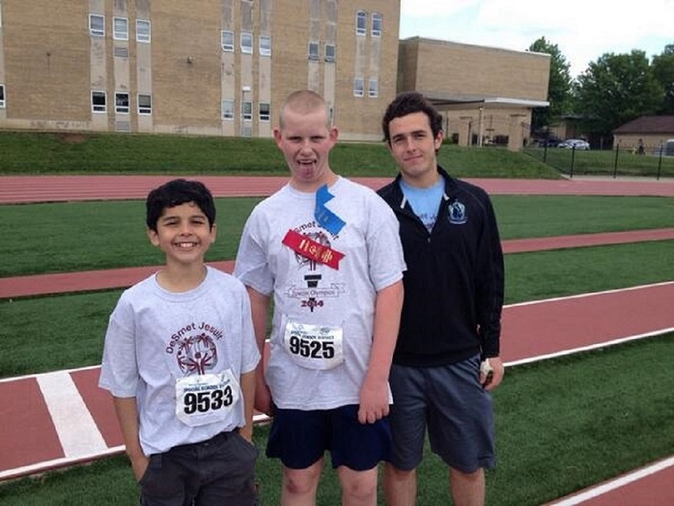
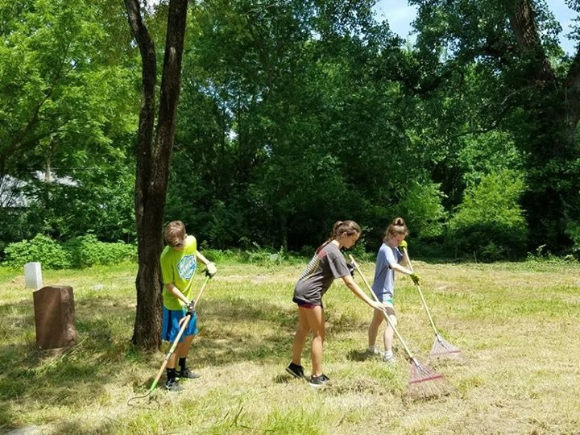
Impact
De Smet Student Body
De Smet STEM Team
Learned to solve problem in community using STEM
Work together for common goal

Slide 5
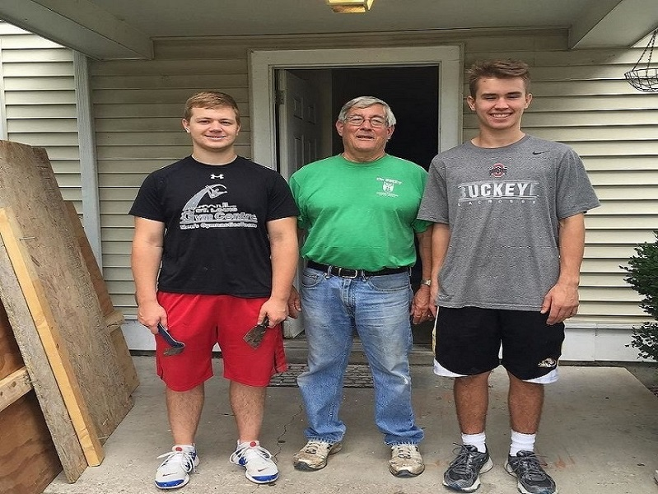
Impact
Faculty
Mr. Lueke (200+ hours)
Environment
Paper waste
Community
Service all over Saint Louis Area
Easy for interface with De Smet Jesuit

Slide 6


Technologies
MySQL
PHP
HTML
Bootstrap
CSS
Javascript
GitHub
Slack
Notes:
These Forms of Code were new to the team. We all had to learn these together as a team. There wasn’t anyone who knew everything.
Communication: Slack, GitHub---Database: Mysql, php, Javascript, html, apache

Slide 7
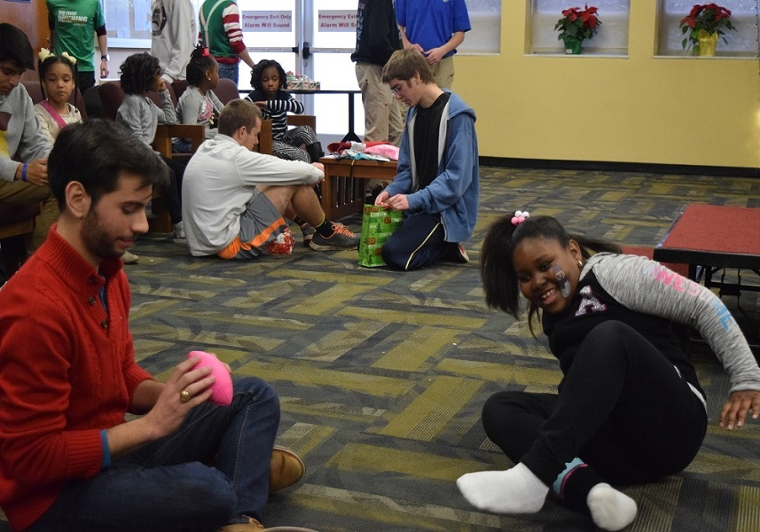
Integration (User Adoption)
Automatic Student Enrollment
Providers
Future:
IT
MySparta
Notes:
Providers: Contact all service providers and have the mix into this system---Mandatory: This website will become mandatory in order to connect to service projects & fulfill service requirements (similar to Moodle)---MySparta: Possible integration into the app---IT: Future presentation to IT over the integration & security risks---

Slide 8
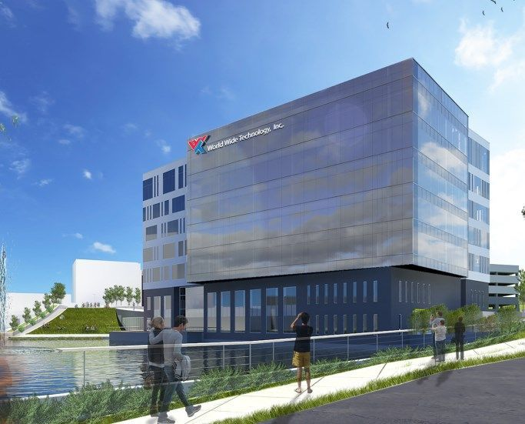
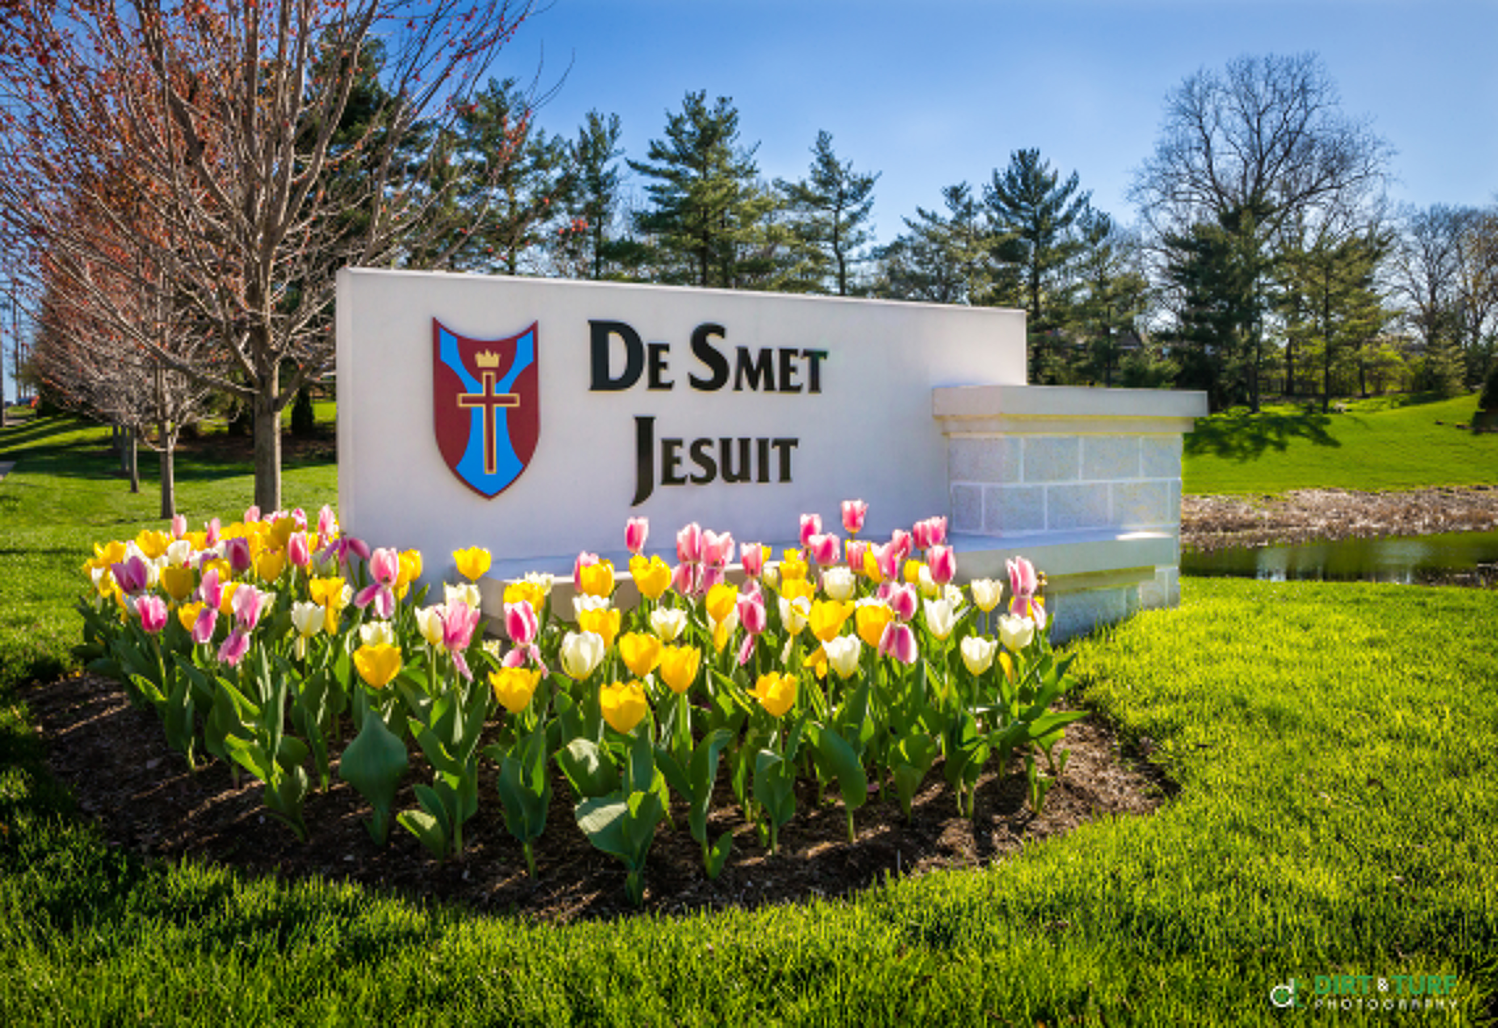
Thank You!

